Slide 1


price prediction
DIAMOND

Slide 2
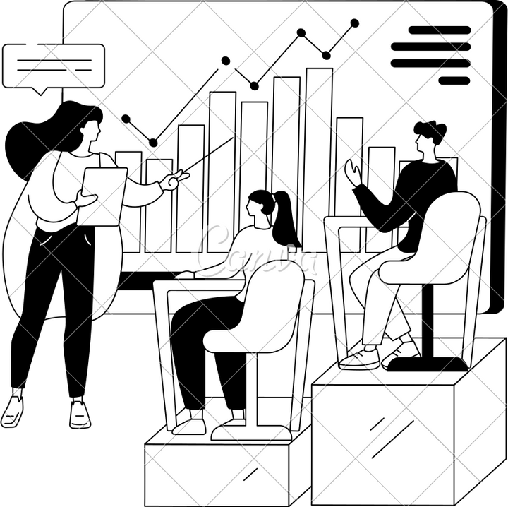
01 02 03 04
05
06
DATA EXTRACTION
DATA CLEANING
DOMAIN KNOWLEDGE
DATA Visualization
Data Preprocessing
Model Training

Slide 3

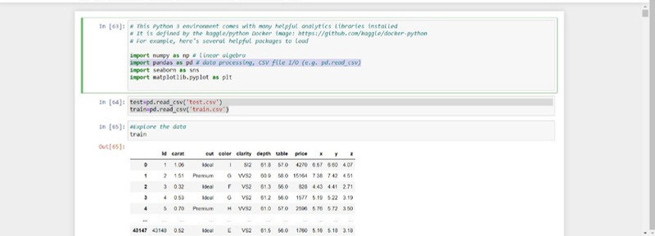
Data Extraction
LOAD DATASET USING PANDAS

Slide 4

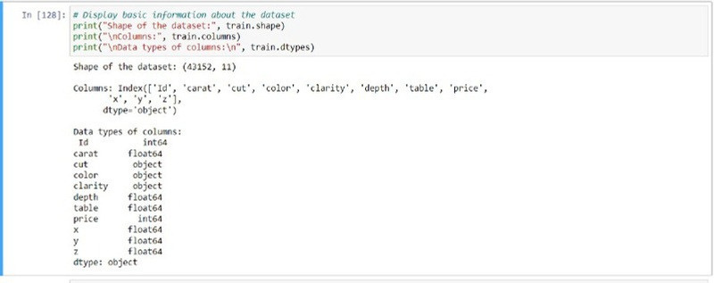

Data Extraction
Overview of the Dataset

Slide 5
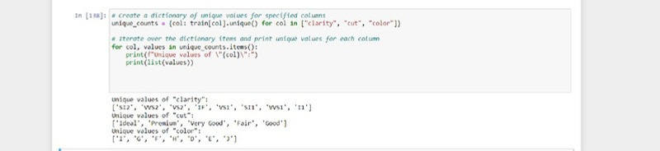
Data Extraction
How much unique categorical data?

Slide 6
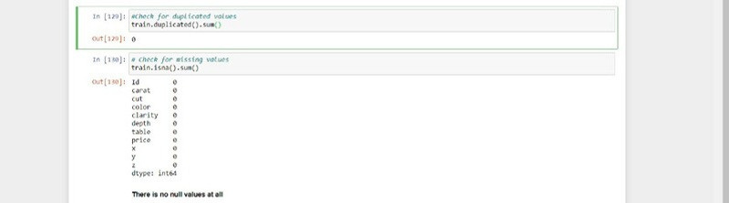
Data Cleaning
Is there null OR duplicated values in data?

Slide 7




Domain Knowledge
DIAMOND THE 4C`S.
These are the most important features.💎
1- Color
2- Clarity 3- Cut grade 4- Carat weight

Slide 8
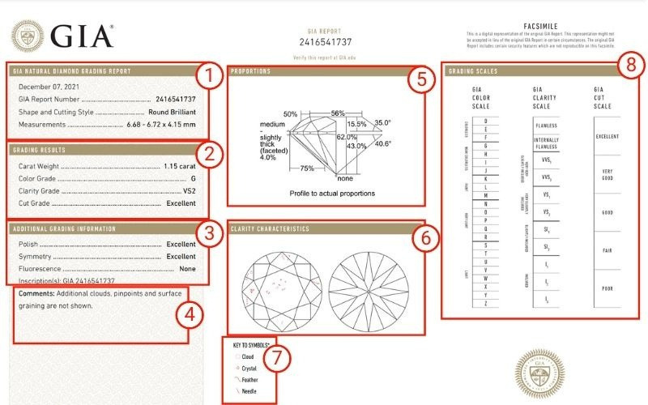
Domain Knowledge
Gemological Institute of America

Slide 9

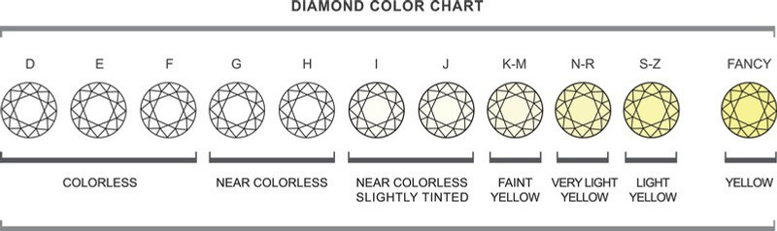
Domain Knowledge
The Gemological Institute of America (GIA) evaluates diamond colors according to a grading system ranging from D (colorless) to Z (light yellow or brown). The differences between these color grades are often subtle and imperceptible to the untrained eye, yet they have a significant impact on the quality and price of the diamond.

Slide 10

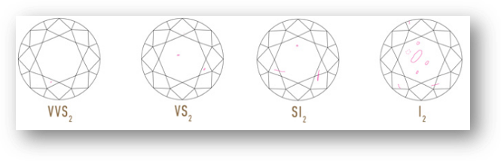
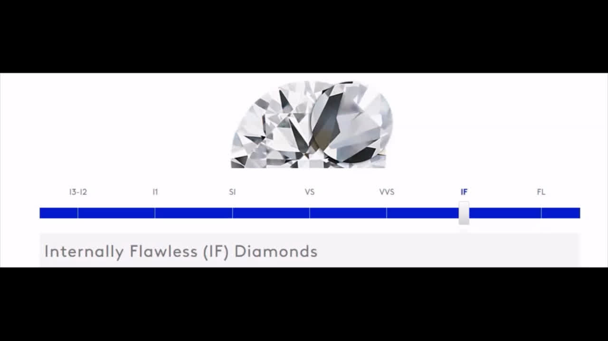
Domain Knowledge
2- Clarity
Diamond clarity is determined by the presence or absence of internal inclusions and external blemishes. Understanding the concept of diamond clarity is essential for comprehending the elements that influence both the quality and price of a diamond.

Slide 11


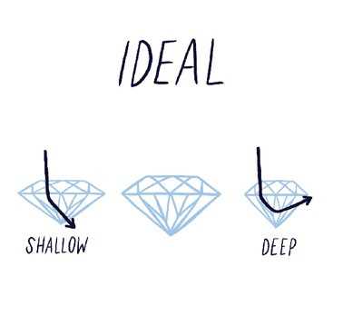
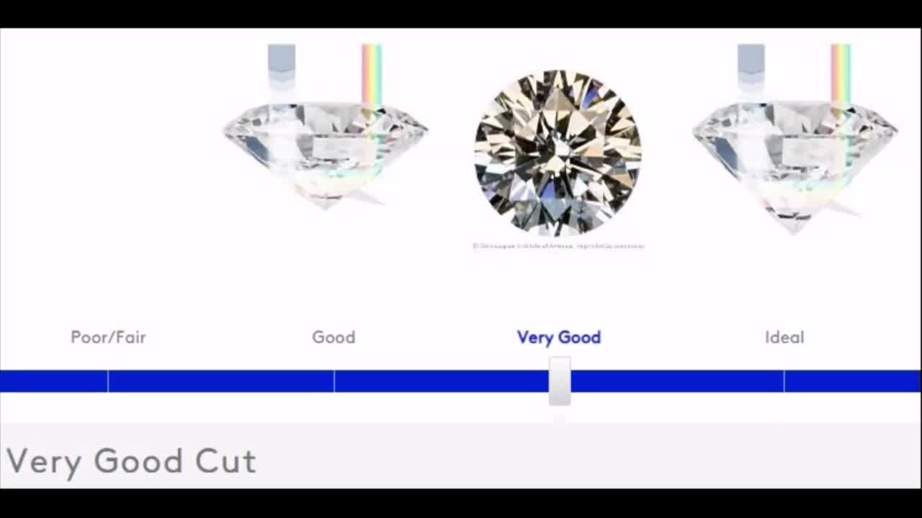

Domain Knowledge
The term "diamond cut" does not describe the shape of a diamond, but rather how well its facets interact with light and the skillfulness of its craftsmanship.
Add a s A well-cut diamond will direct more light through the crown.

Slide 12

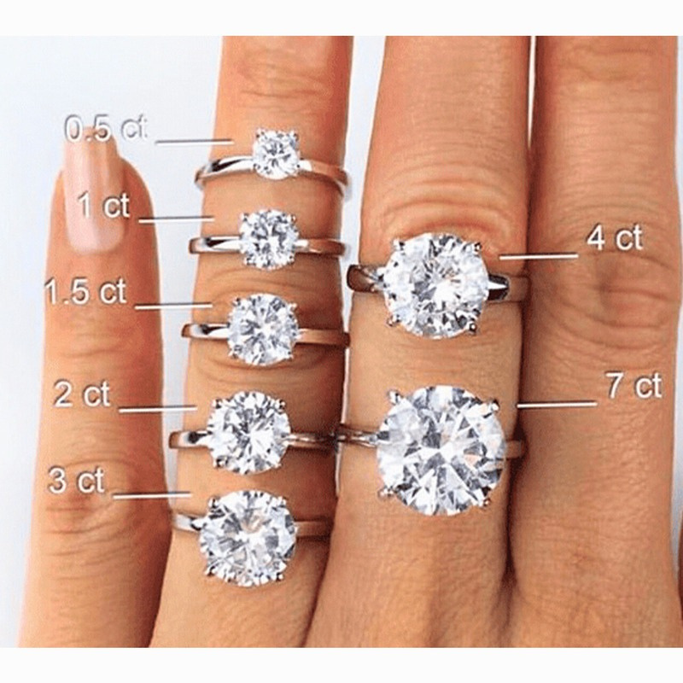
Domain Knowledge
Certainly! The carat weight of a diamond indicates its weight, but two diamonds of the same carat weight can differ significantly in value (and price) based on their color, clarity, and cut.
4.01ct (TDW) Diamond Ring in 18ct Gold Total Carat Weight: 4.01 Carat Centre Diamond Colour: D Colourless Centre Diamond Clarity: VS1 Centre Diamond Cut: Oval Cut (approximately 12mm by 9mm by 6mm) Centre Diamond Setting: Prong/Claw Metal: White Gold; 18 Karat; Stamped 18/750 Ring Style: Traditional Solitaire Center Diamond Certification Report: GIA-5212496818

Slide 13


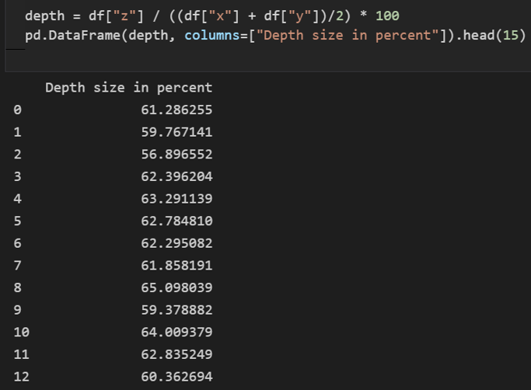

Domain Knowledge
Knowing about depth feature
Original dataset

Slide 14
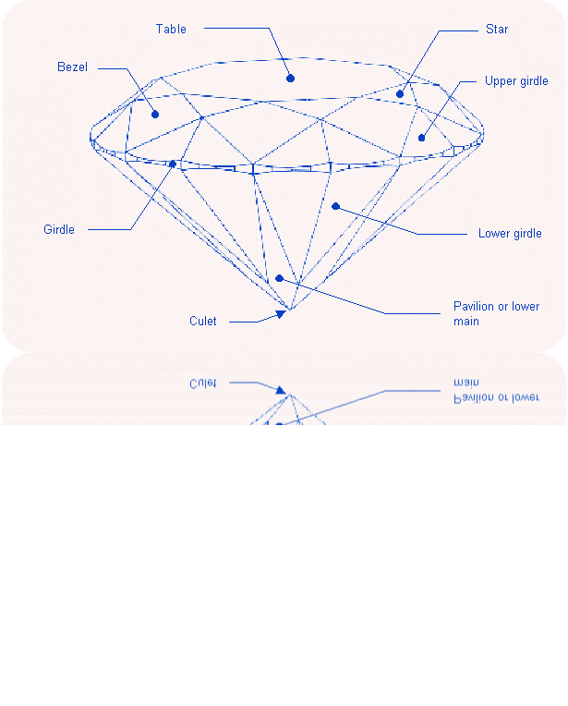
Domain Knowledge
Knowing about table feature.

Slide 15
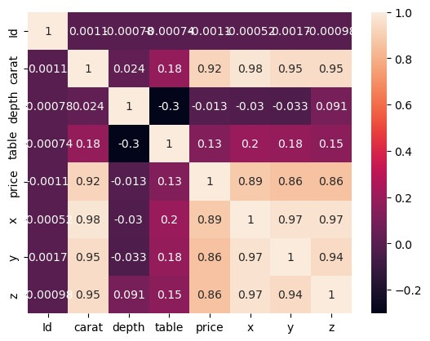

Data Visualization

Slide 16
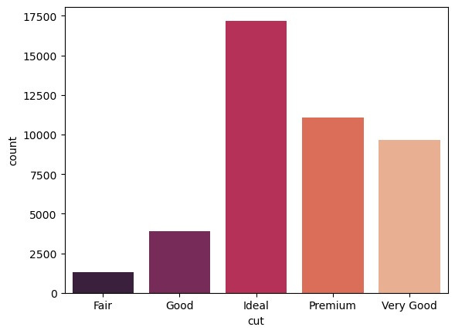

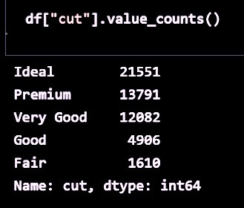
Data Visualization
Count-plot: Cut

Slide 17
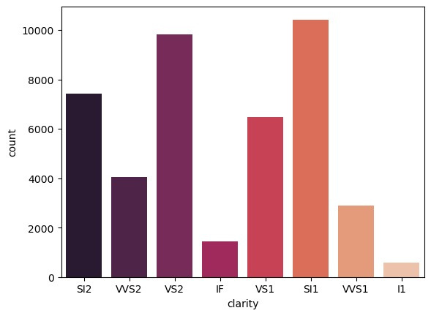
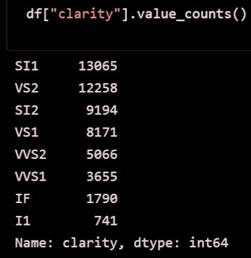
Data Visualization
Count-plot: Clarity

Slide 18
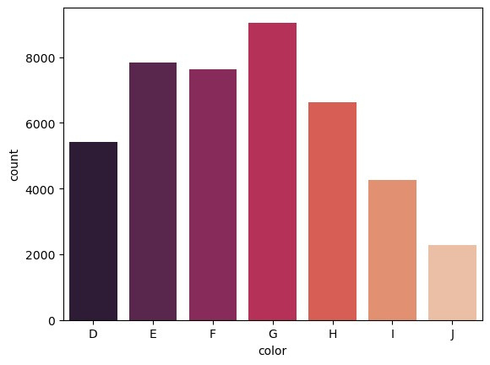
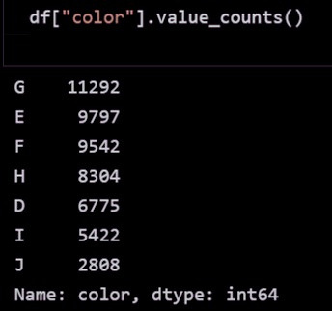
Data Visualization
Count-plot: Color

Slide 19
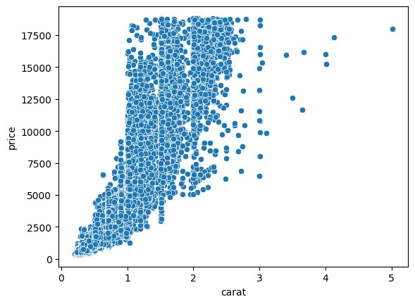
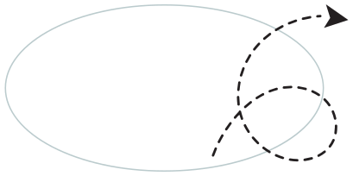
Data Visualization
Outliers?
Relation between carat and price.

Slide 20
Data Visualization
As we know that the relation between carat and price goes exponentially that means carat is so important

Slide 21
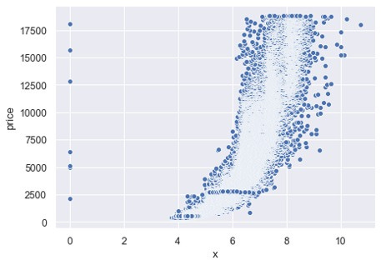


Data Visualization
Outliers?
Relation between X and price

Slide 22
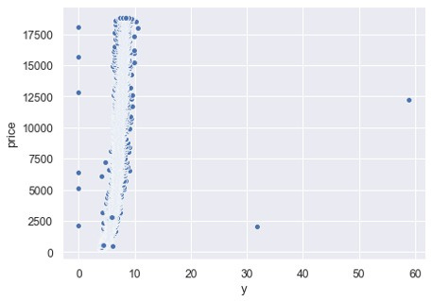

Data Visualization
Outliers?
Relation between Y and price.

Slide 23
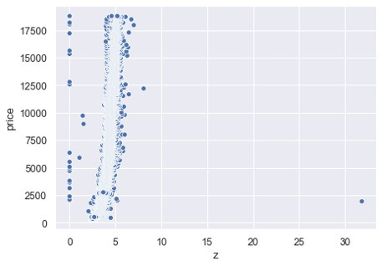

Data Visualization
Outliers?
Relation between Z and price.

Slide 24


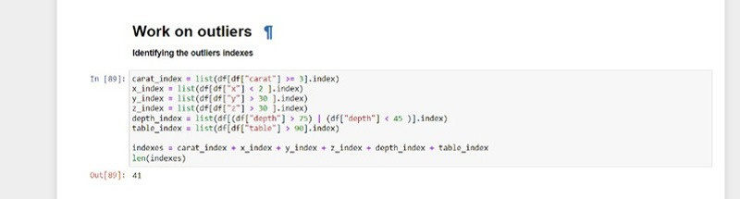
Data Preprocessing

Slide 25

Data Preprocessing

Slide 26

Data Preprocessing
Preprocessing Pipeline for Numerical Features
Objective: Prepare numerical features in the diamond dataset for machine learning models.
Pipeline Steps:
Average Dimension:
Volume Calculation:
Depth with Average Dimension :
Drop Unnecessary Columns: Remove 'x', 'y', 'z', 'depth', and 'Id' columns.
Standard Scaling: Scale numerical features to have zero mean and unit variance.
Result: Transformed numerical features ready for model training.

Slide 27


Data Preprocessing
CONVERT CATEGORICAL DATA
Cut : Ideal > Premium > Very good > Good > Fair
Color : D > E > F > G > H > I > J
Clarity : IF > VVS1 > VVS2 > VS1 > VS2 > SI1 > SI2 > I1

Slide 28
Data Preprocessing
Combined Pipeline for Numerical and Categorical Features
Objective:
Prepare both numerical and categorical features in the diamond dataset for machine learning models.
Pipeline Steps:
Numerical Pipeline: Preprocess numerical features using the above steps.
Cut Encoding: Encode 'cut' feature using ordinal encoding.
Color Encoding: Encode 'color' feature using ordinal encoding.
Clarity Encoding: Encode 'clarity' feature using ordinal encoding.

Slide 29

Data Preprocessing
Result
Transformed dataset ready for model training, with both numerical and categorical features processed appropriately.

Slide 30
Model Training
Regression Model Performance Comparison
Model | RMSE | Performance
Linear Regression | 1204.68 | Higher RMSE, larger prediction error
Decision Tree | 32.16 | Significantly lower RMSE, better pattern capture
Random Forest | 208.09 | Moderate RMSE, good performance but not as accurate as Decision Tree

Slide 31

Model Training
Recommendation
Based on these results, the decision tree model appears to be the most suitable for predicting diamond prices in this dataset, as it achieved the lowest RMSE. Further tuning and evaluation may be beneficial to improve the model's performance.

Slide 32
Model Training
Cross-Validation Results
Model | Mean RMSE | Standard Deviation
Linear Regression | 730.92 | 42.08
Decision Tree | 559.38 | 26.94
Random Forest | 1205.07 | 50.80
SUMMARY:
The Decision Tree model outperformed both Linear Regression and Random Forest, with the lowest mean RMSE of 559.38.
Linear Regression had a moderate performance with a mean RMSE of 730.92.
Random Forest showed the highest mean RMSE of 1205.07, indicating the least accurate performance among the three models.
t

Slide 33
Model Training
Recommendation
Based on these results, the Decision Tree model appears to be the most suitable for predicting diamond prices in this dataset. but when we check it in some test data that we keep from training data we get good result from Random Forest so we use it

Slide 34
Model Training
in test data
Model | RMSE
Linear Regression | 1332
Decision Tree | 1002
Random Forest | 775

Slide 35
Model Training
Fine-Tune
we use GridSearchCV and we get this as the best model with these parameters
RandomForestRegressor(max_features=4, n_estimators=150, random_state=42)

Slide 36
Team : GH
Team members :
Mohamed Hamada ( team Lead)
Elham Mohamad Al Masharfeh
Sara Alhaddadi

Slide 37


